Slide 1




Slide 2
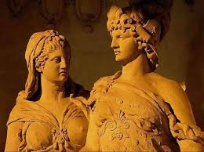
In Ancient Greek Mythology
Ancient Greece was a time of discovery. The scientific and mathematical discovery is renowned and much of what we understand today about our world and solar system has been built from what the Greeks taught us. One large aspect of the Greek culture was their belief in many different Gods. The Majority of the Gods lived on Mount Olympus, a heaven designed only for deities and all powerful beings. Many may know Zeus, God of Lightning and the ruler of all beings on both Mount Olympus and Earth however many do not know he was a descendant from Gaia (Earth) and Uranus along with Hades (God of the Underworld) and Poseidon (God of the Sea).
There are many stories that focus on particular deities and revolve around the sun, moon and stars. Apollo and Artemis, brother and sister, were the God and Goddess of the Sun and the Moon. It was symbolic as they were so different yet each had their role for Earth and were heavily influential amongst the rest of the Gods. Many Greeks worshipped and gave sacrifices to Apollo and Artemis for fear that their rage could destroy their world as they knew it.

Slide 3
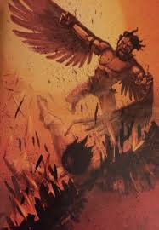
The Story of Icarus and The Sun
Daedalus had been imprisoned by King Minos of Crete within the walls of his own invention, the Labyrinth. But the great craftsman's genius would not suffer captivity. He made two pairs of wings by adhering feathers to a wooden frame with wax. Giving one pair to his son, he cautioned him that flying too near the sun would cause the wax to melt.
But Icarus was a curious boy. He began to fly higher and higher. He was entranced by the light of the sun, and began to fly towards it like a moth to a flame. He had completely forgotten his father's warning. He finally came to a halt in front of the blazing sun and for a few blissful seconds, he revelled in how beautiful it was. But all of a sudden the wax began to melt and the feathers came loose. His wings broke apart and Icarus plunged to his death, landing on the rocks by the sea.

Slide 4



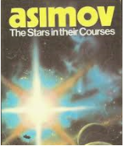
The stars in modern day fiction

Slide 5
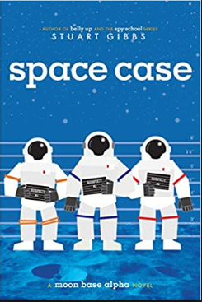
Space Case by Stuart Gibbs
It’s a murder mystery on the moon in this humorous and suspenseful space adventure from the author of Belly Up and Spy School that The New York Times Book Review called “a delightful and brilliantly constructed middle grade thriller.”
Like his fellow lunarnauts—otherwise known as Moonies—living on Moon Base Alpha, twelve-year-old Dashiell Gibson is famous the world over for being one of the first humans to live on the moon. And he’s bored out of his mind. Kids aren’t allowed on the lunar surface, meaning they’re trapped inside the tiny moon base with next to nothing to occupy their time—and the only other kid Dash’s age spends all his time hooked into virtual reality games.
Then Moon Base Alpha’s top scientist turns up dead. Dash senses there’s foul play afoot, but no one believes him. Everyone agrees Dr. Holtz went onto the lunar surface without his helmet properly affixed, simple as that. But Dr. Holtz was on the verge of an important new discovery, Dash finds out, and it’s a secret that could change everything for the Moonies—a secret someone just might kill to keep...

Slide 6

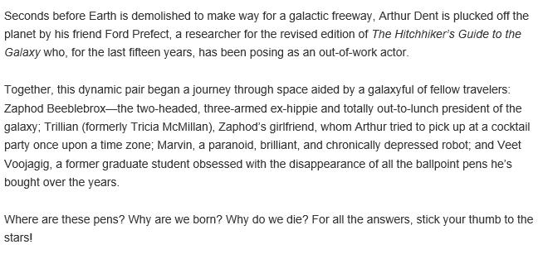
The Hitch-Hiker’s Guide To The Galaxy by Douglas Adams

Slide 7
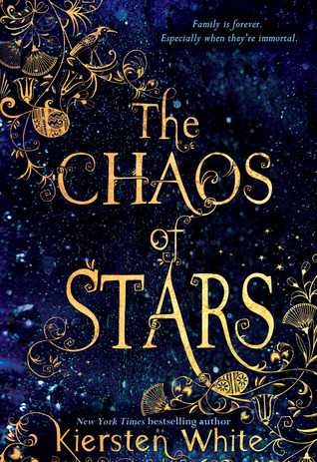
The Chaos of Stars by Kiersten White
Isadora's family is seriously screwed up—which comes with the territory when you're the human daughter of the ancient Egyptian gods Isis and Osiris. Isadora is tired of living with crazy relatives who think she's only worthy of a passing glance—so when she gets the chance to move to California with her brother, she jumps on it. But her new life comes with plenty of its own dramatic—and dangerous—complications . . . and Isadora quickly learns there's no such thing as a clean break from family.

Slide 8

A Cool Moonlight by Angela Johnson
Born with a rare and dangerous allergy to sunlight, Lila's spent her life hidden from the daylight-staying covered up and indoors until dark, only venturing outside after the sun has set and the moon's cool light shines. Almost every night, she is visited by two young girls who wear tutus over their jeans and costume fairy wings, and the three of them dance and tell wonderful stories. But while Lila adores her family and her new friends, still she longs to feel the sun's touch. Lila's mysterious friends have promised to help her . . . but how?

