Slide 1
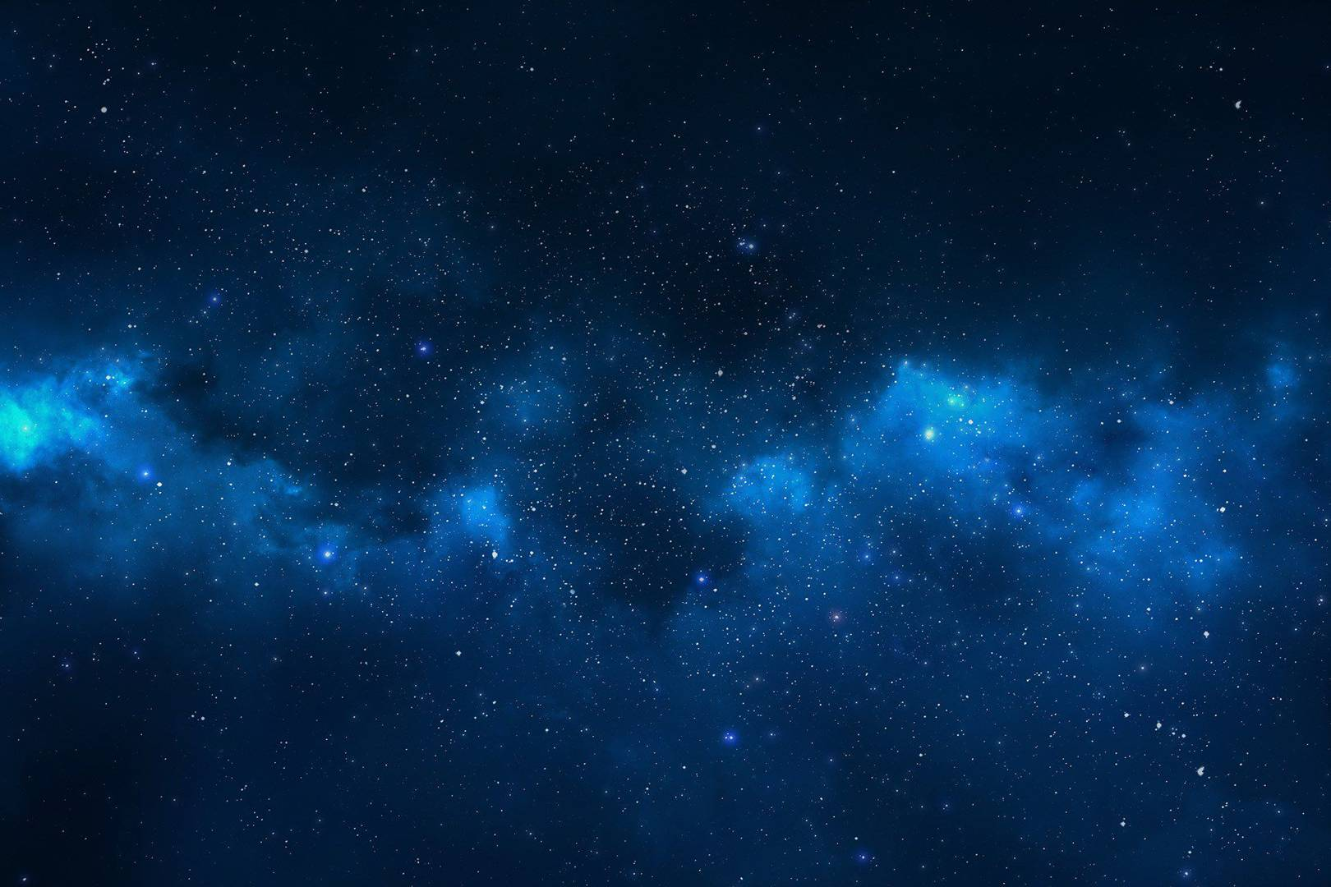
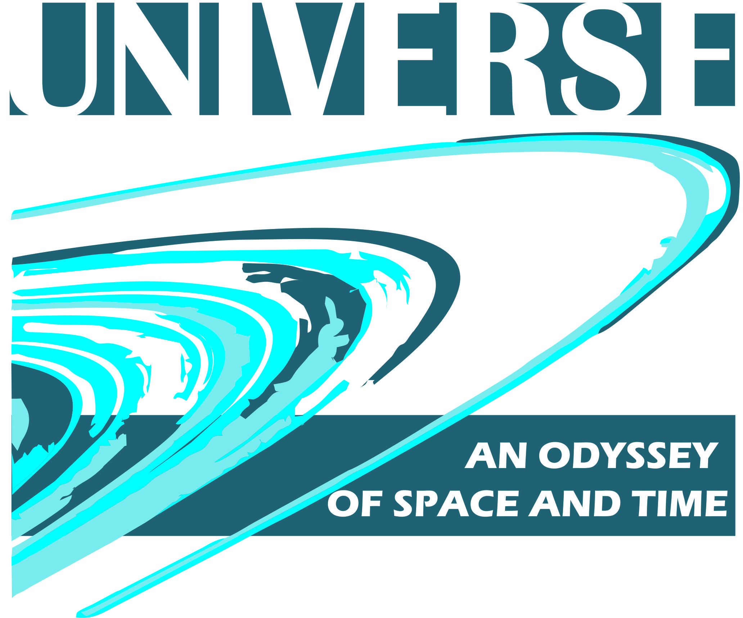


The Solar System
Prepared by the students of
VGTU Engineering Lyceum
2018

Slide 2
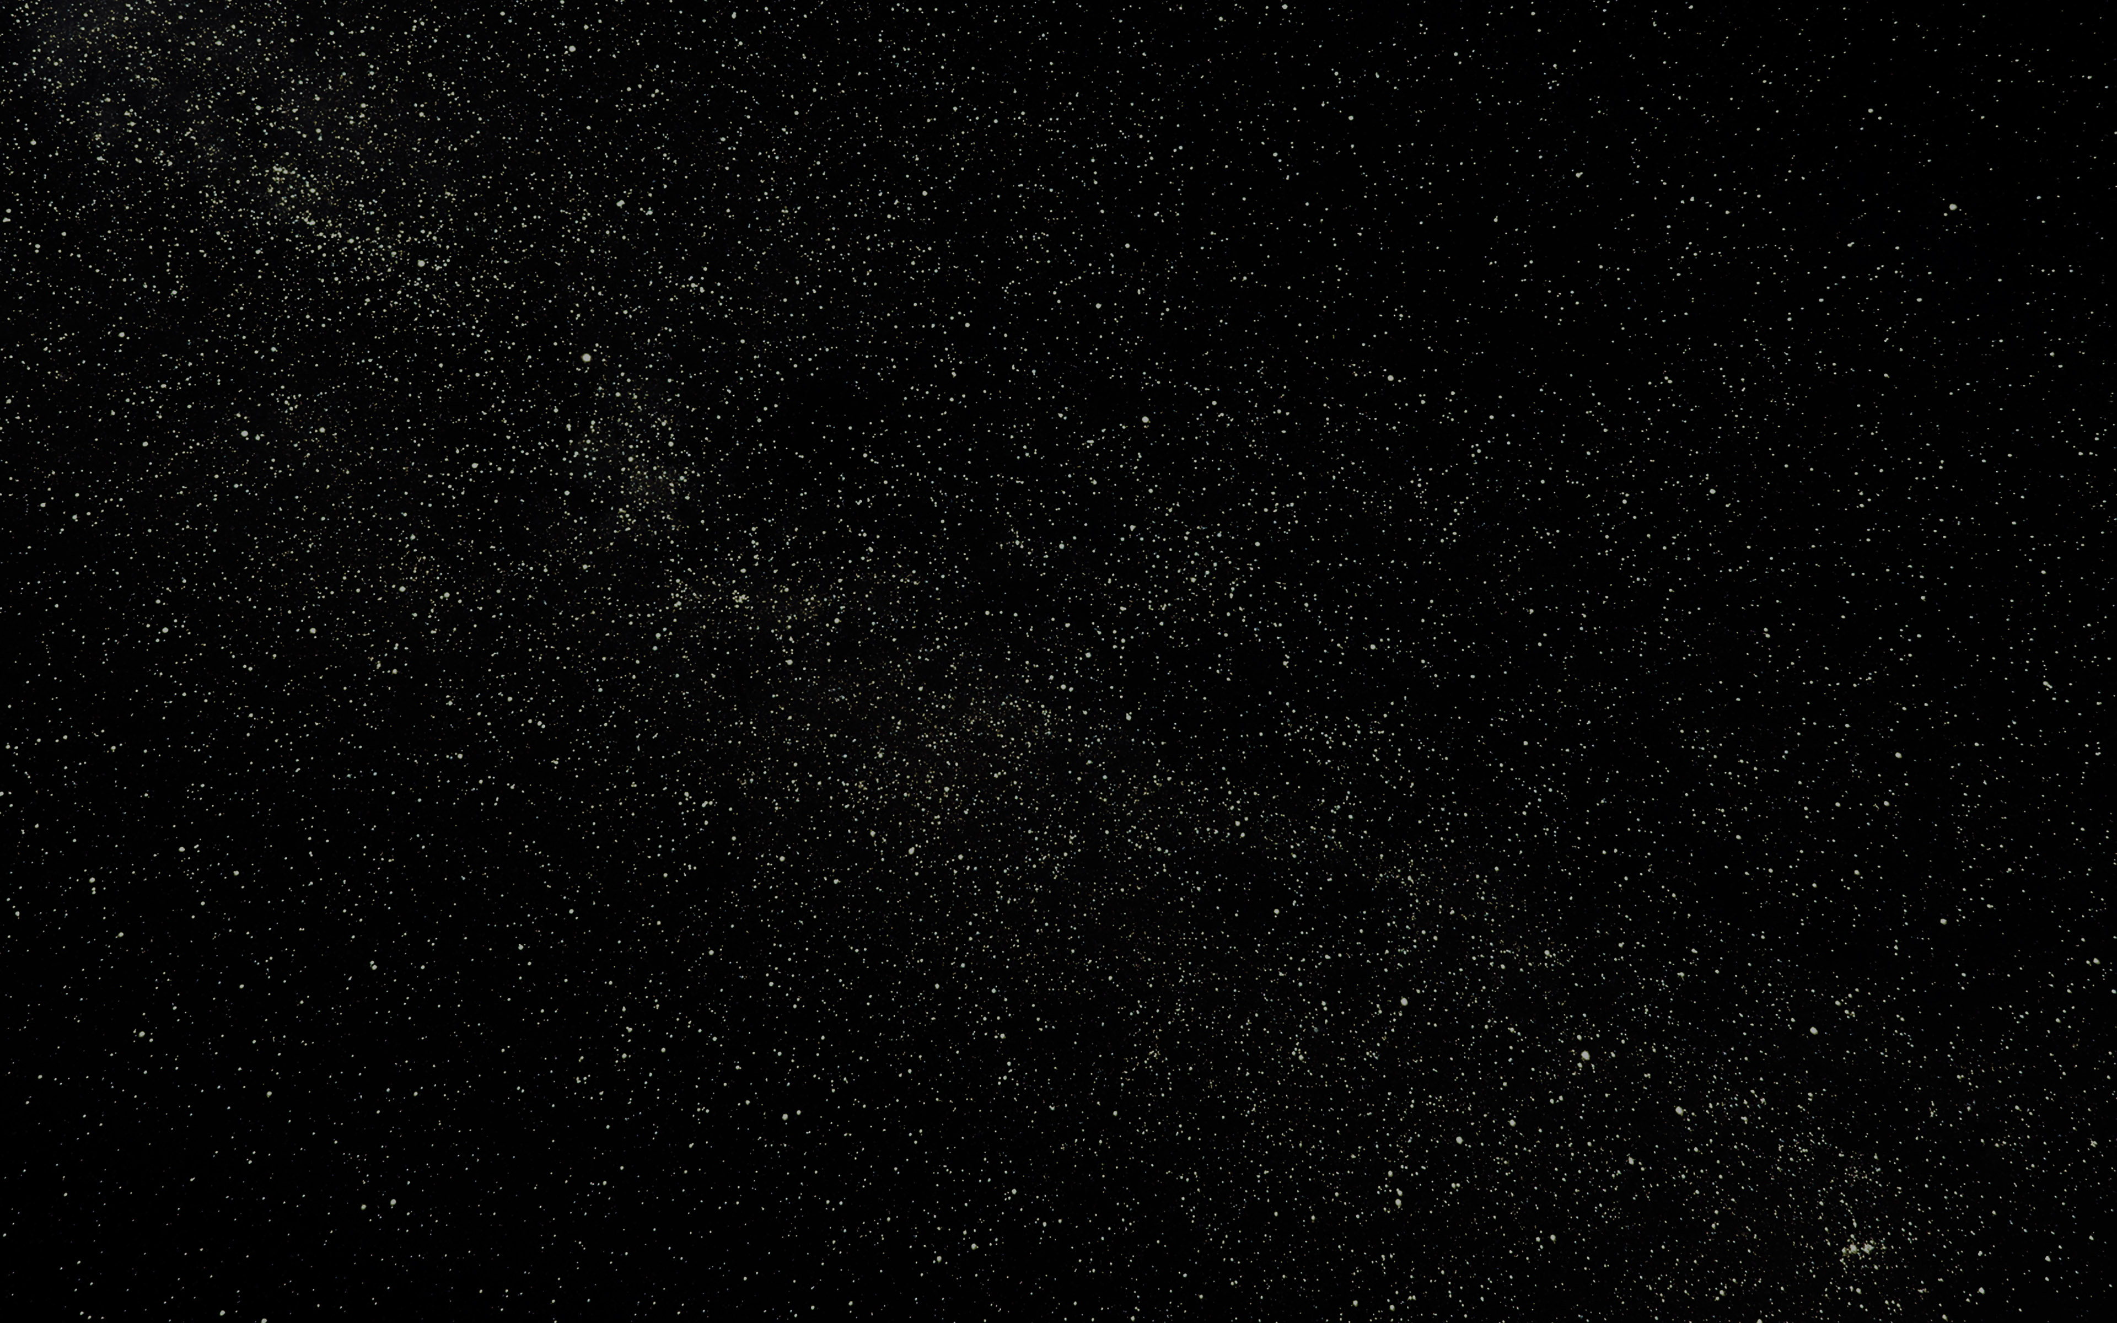
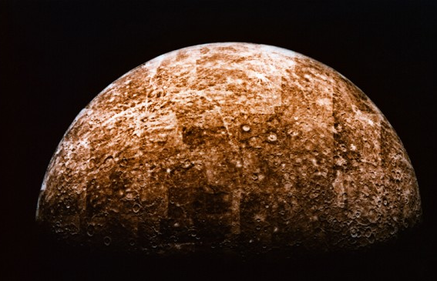
Mercury
The closest planet to the sun.
The temperature varies greatly, ranging from 100 K ( -173 °C ) at night to 700 K ( 427 °C) during the day.
Mercury's surface appears heavily cratered and is similar in appearance to the Moon's.
Humans couldn't live on Mercury, because of the extreme temperature difference's during the day and night.

Slide 3
Venus
The hottest planet in the solar system with a mean surface temperature of 735 K (462 °C ).
Has an atmosphere, consisting of more than 96% carbon dioxide.
Rotates in the opposite direction to most other planets (meaning the Sun would rise in the west and set in the east).
Humans could live on Venus, about 50 kilometers above the surface, where an airspace with similar gravity, pressure and solar radiation protection to Earth is present. The temperature ranges from 30 to 50 degrees Celcius creating a fairly livible atmosphere. Also, the carbon, nitrogen, oxygen, hydrogen and sulfur in Venus's atmosphere could be used to create breathable air, fertilizers and even water.

Slide 4
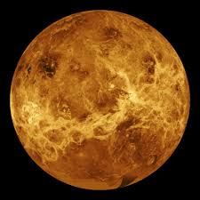
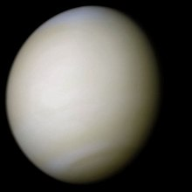
Venus without atmosphere
Venus with atmosphere

Slide 5
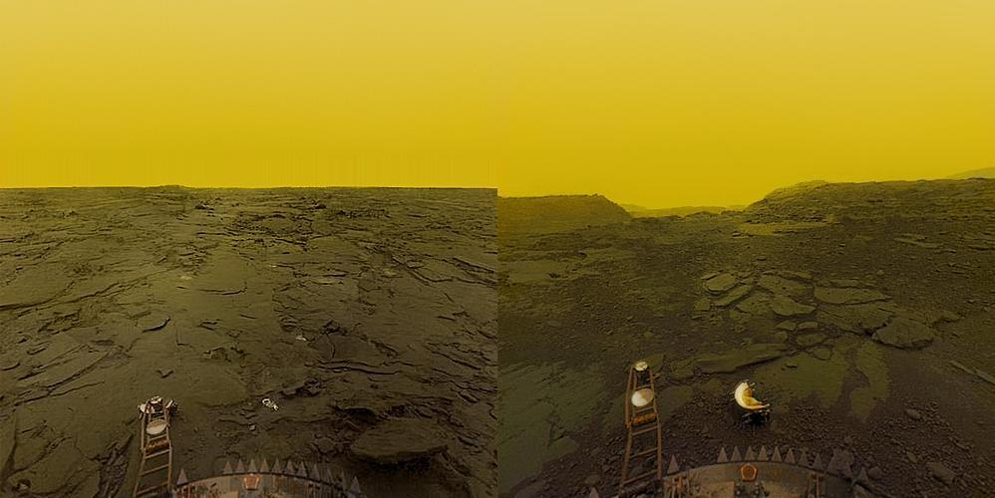
Images of Venus's surface captured by a probe, sent by the USSR in 1975

Slide 6
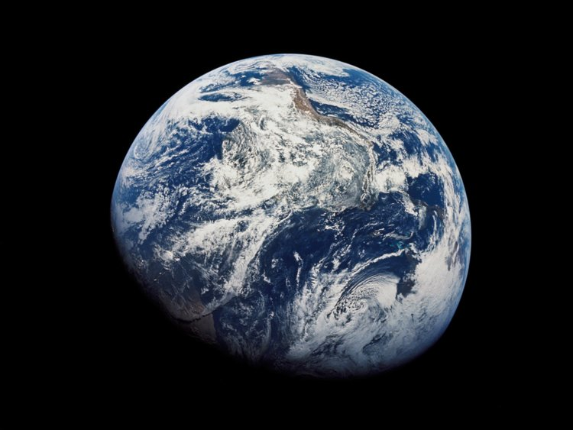
Earth
For a long time humanity thought that Earth was the only planet in the Solar system to contain life, but recent discoveries suggest otherwise.
About 71% of Earth's surface is covered with water, mostly by oceans.
Earth has one natural sattelite - the Moon. Because of the Moon, Earth has tides. It is also said, that the Moon can even influence humans. During certain Moon phases, some people have a hard time sleeping and often suffer from frequent nightmares.
A massive extinction event is currently happening.

Slide 7
Mars
Often referred to as the "Red Planet", because has a reddish tint due to the abundance of iron oxide on the surface.
The temerature can reach 293 K ( 20 °C ) at the equator and drop to 120 K ( -153 °C ) at the poles.
The planet has poles, which consist of water and carbon dioxide ice. Sometimes ice clouds form above them.
Used to contain life and was very similar to Earth, because it had huge oceans and plant life. But due to low gravity, it's atmosphere slowly dissapeared and Mars turned into a red, dead, cold planet, that we see today.
NASA and SpaceX plan to colonize the planet in the next 30 years.
Mars is home to Olympus Mons ( Mt. Olympus ), which is the highest peak on the planet and the whole Solar system. It's height is 24 km, roughly three times higher than Mt. Everest.

Slide 8
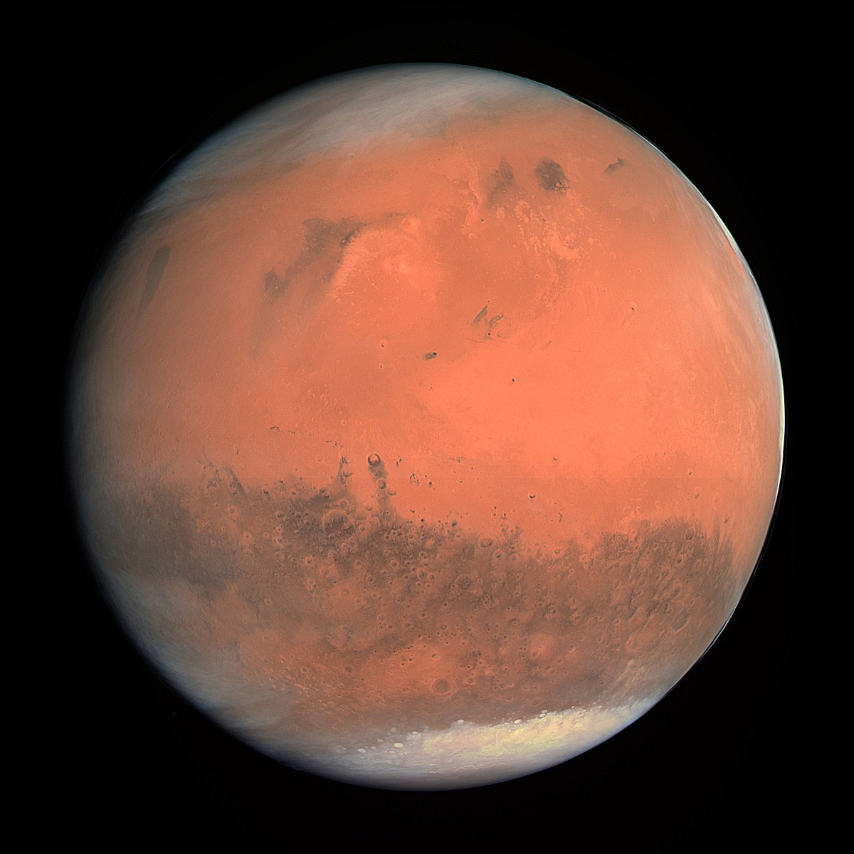
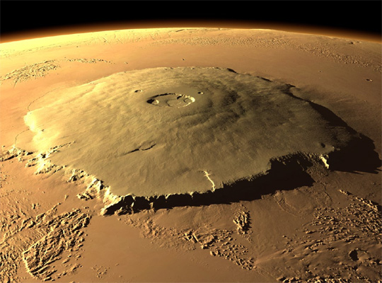
Mars
Mt. Olympus

Slide 9
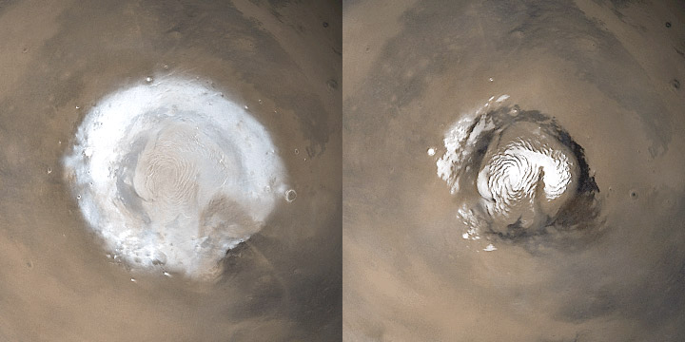
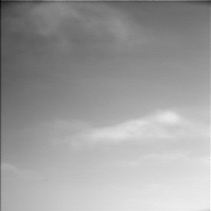
Mars's poles:
The south pole
The north pole
Moving ice clouds

Slide 10
Jupiter
The largest planet in the Solar system.
Jupiter is primarily composed of hydrogen with a quarter of its mass being helium. It may also have a rocky core of heavier elements, but like the other giant planets, Jupiter lacks a well-defined solid surface.
The outer atmosphere is visibly segregated into several bands at different latitudes, resulting in turbulence and storms along their interacting boundaries. A prominent result is the Great Red Spot, a giant storm that is known to have existed since at least the 17th century when it was first seen by telescope.
The temperature in the clouds of Jupiter is about 128 K (-145 °C). The temperature near the planet's center is much, much hotter. The core temperature may be about 24275 K ( 24,000 °C). That's hotter than the surface of the sun!

Slide 11
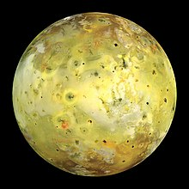
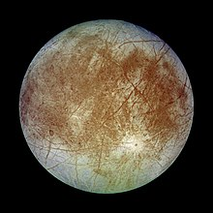
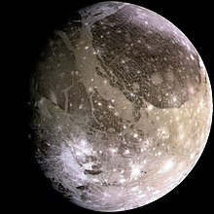
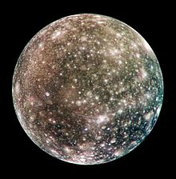
A Category Five hurricane, the strongest class on Earth, has winds raging at more than 250 km/h, and they usually max out around 320 km/h. Jupiter's Little Red Spot could blow them away with winds of about 620 km/h.
Jupiter has 79 known moons, including the four large Galilean moons discovered by Galileo Galilei in 1610. Ganymede, the largest of these, has a diameter greater than that of the planet Mercury.
The Galilean moons are the four largest moons of Jupiter:
Io
Europa
Ganymede
Callisto

Slide 12
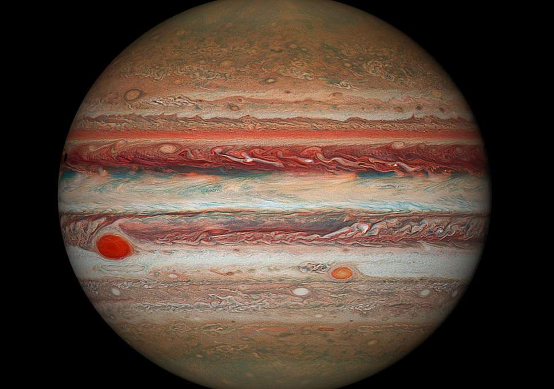
The Great Red spot
The Little Red spot
Jupiter

Slide 13
Saturn
Saturn's interior is probably composed of a core of iron–nickel and rock. This core is surrounded by a deep layer of metallic hydrogen, an intermediate layer of liquid hydrogen and liquid helium, and finally a gaseous outer layer.
Saturn has a pale yellow hue due to ammonia crystals in its upper atmosphere.
The planet's most famous feature is its prominent ring system that is composed mostly of ice particles, with a smaller amount of rocky debris and dust.
At least 62 moons are known to orbit Saturn. Titan, Saturn's largest moon, and the second-largest in the Solar System, and is the only moon in the Solar System to have a substantial atmosphere.

Slide 14
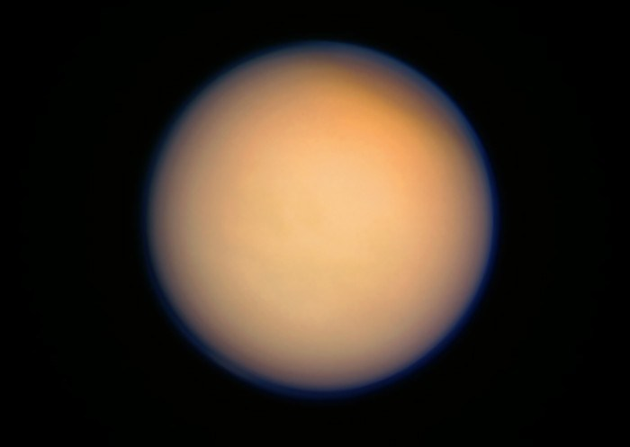
On the surface, Saturn's average temperature varies from about 88 K (-185 °C) to 151 K (-122 °C). The temperature variation is due to the planet's internal processes, not the sun. As you dive through the clouds, temperatures increase to Earth-like conditions. At its core, scientists believe Saturn's temperature is more than 8570 K (8,300 °C).
Saturn's moon Titan

Slide 15
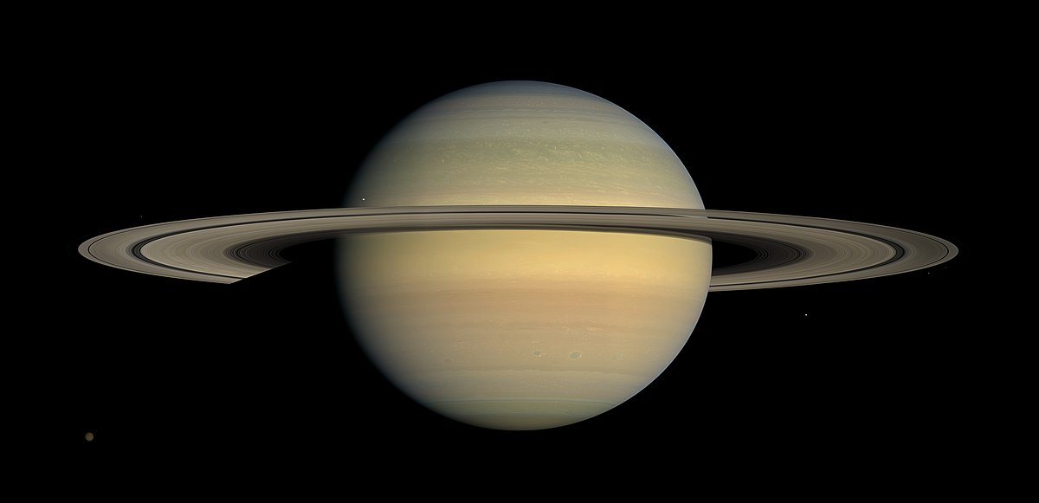
Saturn

Slide 16
Uranus
Uranus is similar in composition to Neptune, and both have bulk chemical compositions which differ from that of the larger gas giants Jupiter and Saturn. For this reason, scientists often classify Uranus and Neptune as "ice giants" to distinguish them from the gas giants.
Uranus' atmosphere is similar to Jupiter's and Saturn's in its primary composition of hydrogen and helium, but it contains more "ices" such as water, ammonia, and methane, along with traces of other hydrocarbons.
It has the coldest planetary atmosphere in the Solar System, with a minimum temperature of 49 K (−224 °C).
Has a complex, layered cloud structure with water thought to make up the lowest clouds and methane the uppermost layer of clouds. The interior of Uranus is mainly composed of ices and rock.

Slide 17
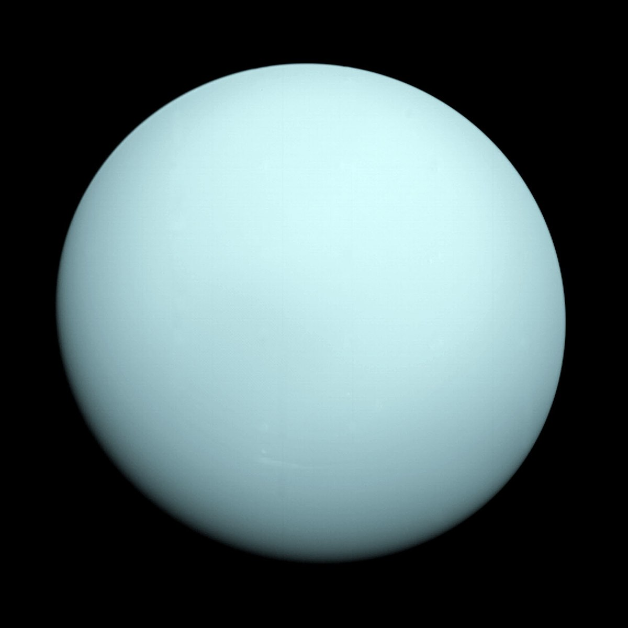
It's axis rotation is tilted sideways, nearly into the plane of its solar orbit. Its north and south poles, therefore, lie where most other planets have their equators.
Wind speeds can reach 250 m/s (900 km/h).
Uranus

Slide 18
Neptune
Like Jupiter and Saturn, Neptune's atmosphere is composed primarily of hydrogen and helium, along with traces of hydrocarbons and possibly nitrogen, but it contains a higher proportion of "ices" such as water, ammonia, and methane.
Its interior, like that of Uranus, is primarily composed of ices and rock.
Traces of methane in the outermost regions in part account for the planet's blue appearance.
The planet's southern hemisphere has a Great Dark Spot comparable to the Great Red Spot on Jupiter.
Wind speeds can reach as high as 2,100 km/h.
Because of its great distance from the Sun, Neptune's outer atmosphere is one of the coldest places in the Solar System, with temperatures at its cloud tops approaching 55 K (−218 °C; −361 °F). Temperatures at the planet's centre are approximately 5,400 K (5,100 °C; 9,300 °F).

Slide 19
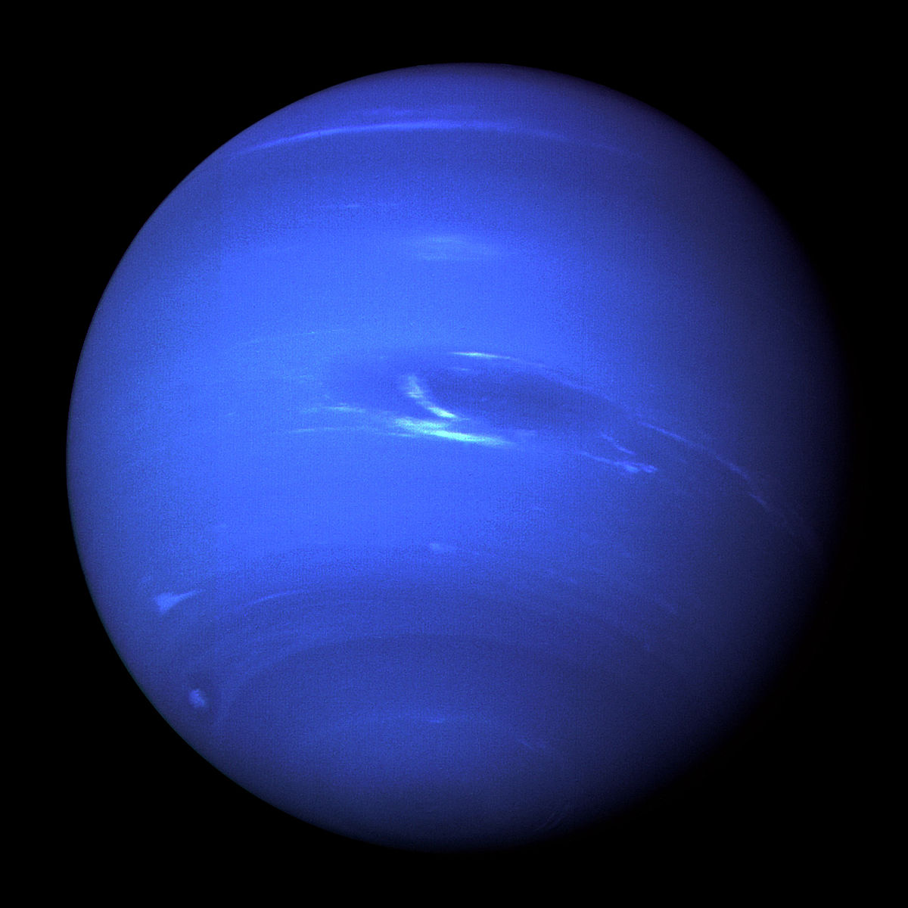
The Great Dark spot
Neptune

Slide 20
Sources
Mercury:
https://en.wikipedia.org/wiki/Mercury_(planet)
Venus:
https://en.wikipedia.org/wiki/Venus
https://www.youtube.com/watch?v=HyAG1Oien4M
Earth:
https://en.wikipedia.org/wiki/Earth
Mars:
https://en.wikipedia.org/wiki/Mars
https://mars.nasa.gov/
https://solarsystem.nasa.gov/planets/mars/overview/
Jupiter:
https://en.wikipedia.org/wiki/Jupiter
https://solarsystem.nasa.gov/planets/jupiter/overview/
Saturn:
https://en.wikipedia.org/wiki/Saturn
https://solarsystem.nasa.gov/planets/saturn/overview/
Uranus:
https://en.wikipedia.org/wiki/Uranus
https://nineplanets.org/uranus.html
Neptune:
https://en.wikipedia.org/wiki/Neptune
http://solarviews.com/eng/neptune.htm
https://solarsystem.nasa.gov/planets/neptune/overview/

